Slide 1

The Case Study Of
Soccer Judgement
Involving Technology
Evaluating The Scored Goal By Ao Tanaka For The Samurai Blue
At The World Cup Qatar 2022
Written By :
Lecturer :
Lecture :
Course :
Department :
Montaha Dow Gayeed
Bayram Zarty
Principle 4 -The Judgement
SE Code Of Ethics
Software Engineering

Slide 2
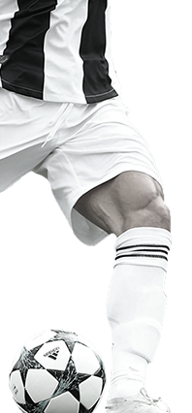
Contents
01
Soccer
What is the aim of the game ?
.
02
Development
How has the technology affected Soccer ?
03
AL Rihla
The official ball of world cup Qatar 2022 .
With a new technique .
Judgement
04
How many referees in Soccer ?
What are techniques used to support this system ?
Techniques
05
Video Assistant Referee.
Semi-Automated Offside Technology.
Understanding The Mechanism
06
Trying to make an acceptable result for human .

Slide 3
Soccer
The sport of the century , it is well renowned the most favorite of all sports. Although it’s not the only sport that has exciting events , it’s the only sport agreed world wide proven it’s the most valued , the World Cup as it being the biggest event worldwide bringing together 32 countries.
Soccer consists of two teams, each team is made up of eleven players in the stadium with the area of 7140 m , the aim of the game is to kick the ball in a net with a square area of 2.44 * 7.32 for 90 minutes exactly with a break in between .

Slide 4
Development
As everything else in the world , soccer went through development . FIFA adds rules gradually in order for the game to be more fair as in adding technology and having people assigned to watch for foul play (VAR) . The latest two techniques , The first is called SAOT to determine offside mistakes , and the second is ball with IMU Sensor gives readings of the velocity, direction , and most importantly the location in the field in order to apply the new rule “ The ball being out of bounds stops the play ” . So let’s have a look at the ball of the World Cup 2022 .
VAR

Slide 5


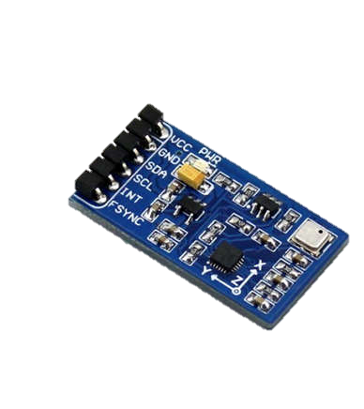
AL Rihla
Al Rihla has been revealed by Adidas as the Official Match Ball for the FIFA World Cup Qatar 2022 . The ball is the best in soccer history as it has fulfilled all standards by developing with a new technique to apply the new rule which is about when the ball goes out of bound or out of the selected area of the play . Designed from the inside out using data and rigorous testing at Adidas labs, in wind tunnels and on the pitch by football players themselves, Al Rihla provides the highest levels of accuracy and reliability on the field of play, partly due to its new panel shape and surface textures.
What is an IMU Sensor?
An electronic device used to calculate and reports an exact force of body, angular rate as well as the direction of the body, which can be achieved by using a blend of 3 sensors like Gyroscope, Magnetometer, and Accelerometer.

Slide 6
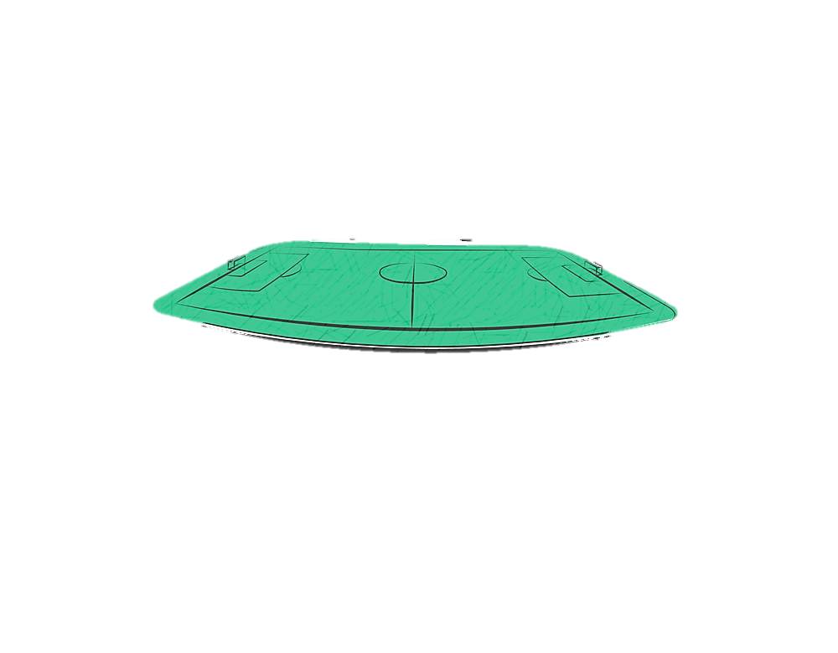
Q – Is this sport made up of 22 players in an open field in need of being so accurate and precise in dealing with the wide area of the ball ?
Let’s have a look at the Judgement System …..

Slide 7
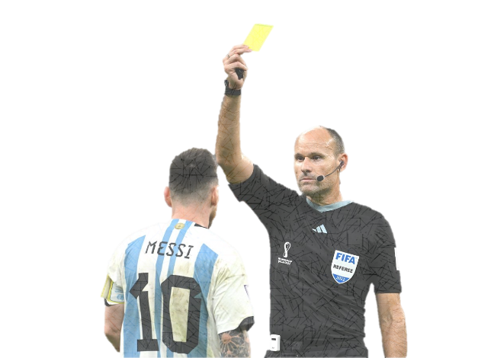
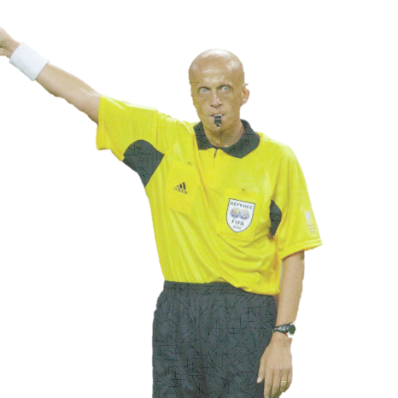
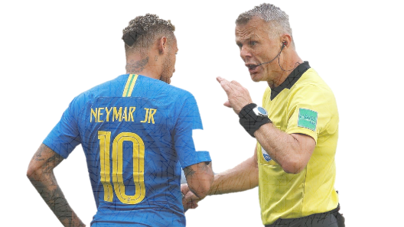
Judgement System
The referees in soccer are four , Two Assistant Referees , one on each side decides offside and the free kick closest to him , Another Referee supervises the substitute players . Finally , The Referee In The Area During The Play , who is The most important and special one . The one who acts on the rules and controls the play throughout the whole game by coordinating with the other referees , calculating the time period of the game , and records the events that occur during the game , where there is a complete report of any event that has occurred before , during or even after the game .
This system is supported by technique and people assigned to watch for foul play.

Slide 8
Techniques
The evolution in technology has helped support the referees calls during the game where it depends on philosophy “ Minimal Intervention For The Best Results “ reinforcing justice during the game .
VAR – Video Assistant Referee
SAOT - Semi-Automated Offside Technology

Slide 9
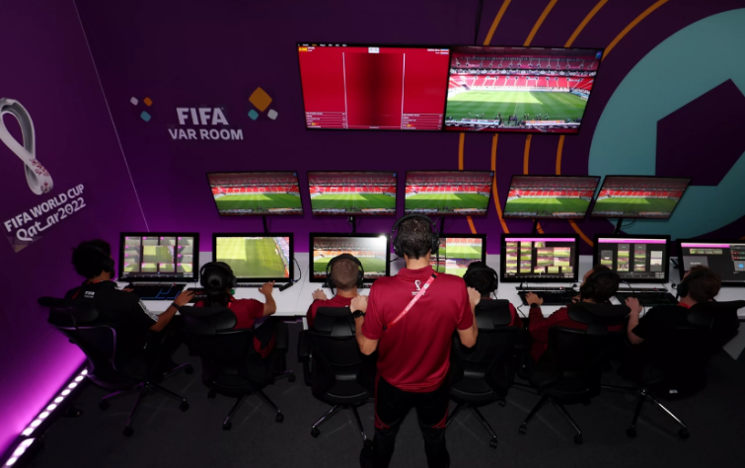
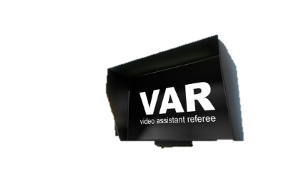
VAR – Video Assistant Referee
The referees can make a decision of foul play by using videos , this technique has been added to the rules of the game by FIFA in 2018.
The group of referees that work with videos are formed of a video assistant referee , three assistants and three specialists in filming the angles that show the play the best . and that is by 42 cameras specifically for broadcasting the game and the team replays the videos in slow motion to investigate exactly what has occurred. This team supports the referee in the area during the play who will make the final decision . the team is capable to determine offside positions by Semi-Automated Offside Technology .

Slide 10
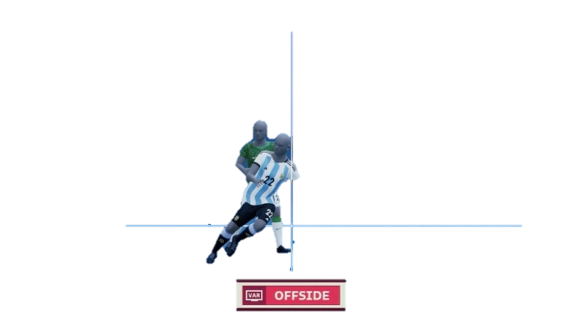
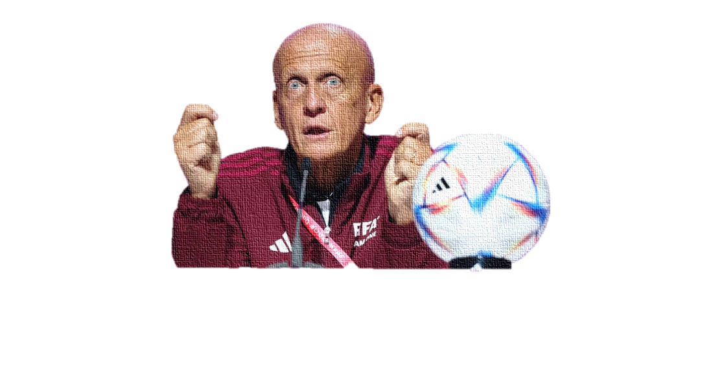
SAOT - Semi-Automated Offside Technology
A Technology is to investigate offsides and supported by 12 cameras specific for observation allowing the referee to review the exact Moment of the ball being kicked and also to review the offside line, they are confirmed electronically . The offside technology provides accuracy of making a decision concerning the play.
Collina “ With SAOT we can make quicker and more accurate decisions “

Slide 11

This is the supported referee system in the games as it supports the final decision of the game.
In my opinion , this system does not need technology to give a precise result , however from some aspects it was nothing but an exaggeration and it was best to leave this rule for the referee to decide on instinct rather than to be decided by a technique , or decrease the accuracy to make the technique result acceptable to the people .

Slide 12
Understanding the mechanism
Let’s assume after the reaction given by the international newspapers , especially Germany that criticized this goal which kicks Die Mannschaft out , The technique will be improved .
If we try to imagine the mechanism as a simple java programming part takes control when the ball going out of bounds .

Slide 13
The Main Thoughts :
Let’s say the IMU sensor gives the radius of the ball as two arrays of 22 items , one for location on x axis and another for locations on y axis , we get this :
Int x [21]
Int y [21]
Now , we need a function dealing with the location of the ball ( The two arrays x and y ) , the function will test , if the given location is included in the play area .
Void checkCollision ( )
The Last thing is needed , a Boolean variable for storing the final result .
Boolean ballin = false
22cm
Mechanism

Slide 14
public Class Calculation {
// attributes ……
final long width = 68 ;
final long height = 105 ;
final int x[] = new int [21 ] ;
final int y[] = new int [21 ] ;
Boolean ballin = false ;
//dealing with limits
public void checkCollisin( ) {
//check if ball touches left border
if(x[0] < 0) { ballin = false; }
//check if ball touches right border
if(x[22] > width) { ballin = false; }
//check if ball touches top border
if(y[0] < 0) { ballin = false; }
//check if ball touches bottom border
if(y[22] > height) { ballin = false; }
}
//dealing with the result
public void checkCollisin( ) {
if ( ballin == false) stopGame( ); } }

Slide 15
public Class Calculation {
// attributes ……
final long width = 68 ;
final long height = 105 ;
final int x[] = new int [21 ] ;
final int y[] = new int [21 ] ;
Boolean ballin = false ;
//dealing with limits
public void checkCollisin( ) {
//check if ball touches left border
if(x[0] < 0) { ballin= false; }
//check if ball touches right border
if(x[10] > width) { ballin = false; }
//check if ball touches top border
if(y[0] < 0) { ballin = false; }
//check if ball touches bottom border
if(y[10] > height) { ballin = false; }
}
//dealing with the result
public void checkCollisin( ) {
if ( ballin == false) stopGame( ); } }
Making the view more acceptable
If we change conditions to dealing with the half of the ball which means if it goes out the white line then game must be stopped , this makes the view acceptable to people .
IF the location of item 10 in array x = 68 , or in array y = 105
Then the ball is out

Slide 16
Of course this is not the correct idea and every coach and player understand the need of the rule and how the technique is highly accurate , but from soccer fan perspective , I think it’s a harsh rule , and from software engineer perspective ,the technique is too accurate to be used in a sport like Soccer
Reference : FIFA

